Slide 1
Bus Reservation
By:- Binaya Dahal

Slide 2
Table of content
Introduction
Problem statement
Literature Review
Objectives
System Architecture
Context Level Diagram
Data Flow Diagram
Usecase Diagram

Slide 3
Introduction
An online portal for bus ticket reservation
Aims to make bus reservation easy
Allows user to choose seat of their choice

Slide 4
Problem statement
Need to contact travel agency to book a ticket
Not all travel agency have their own online bus reservation system
Hard to book bus at festival season
Lack of proper web portal for bus reservation

Slide 5
Literature review
westnepalbus.com
They provide:
Destination choice
Date and shift choice
They lack:
Doesn’t show bus availability
Need to call office to see if bus exists

Slide 6
Literature Review (Continued)
travelnepalbus.com
They provide:
Destination choice
Date and shift choice
They lack:
Only 3 destination, from within the valley
No search result after searching
Need to call to see if bus is available

Slide 7
Literature Review (Continued)
Bussewa.com
They provide:
Destination choice
Date and shift choice
They lack:
Need to type in the destinations and date of depature
Most of the links were dead (site may be having issue)

Slide 8
Objectives
To provide all small level travel agency a platform to expand their business
To provide users with option to choose from variety of travel agency on single place.

Slide 9
System Architecture
The system will consists of 3 types of user:
User: normal user that book tickets
Agency User: member of travel agency that can add / remove routes, buses under its supervision and tickets cancellation
Agency Admin: access similar to Agency user but has usermanagement facility to manage it employee
Super Admin: master user that can add/remove travel agency, agency admin and places

Slide 10
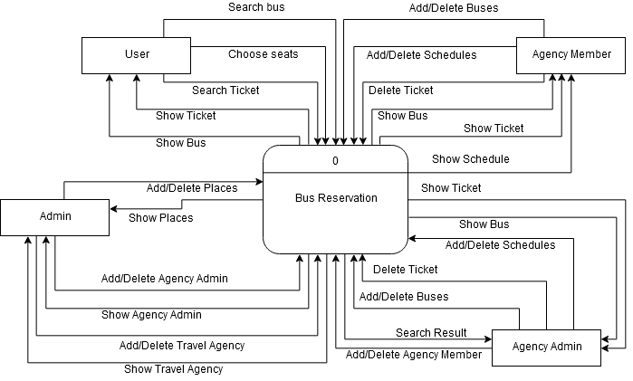
Context Level Diagram

Slide 11
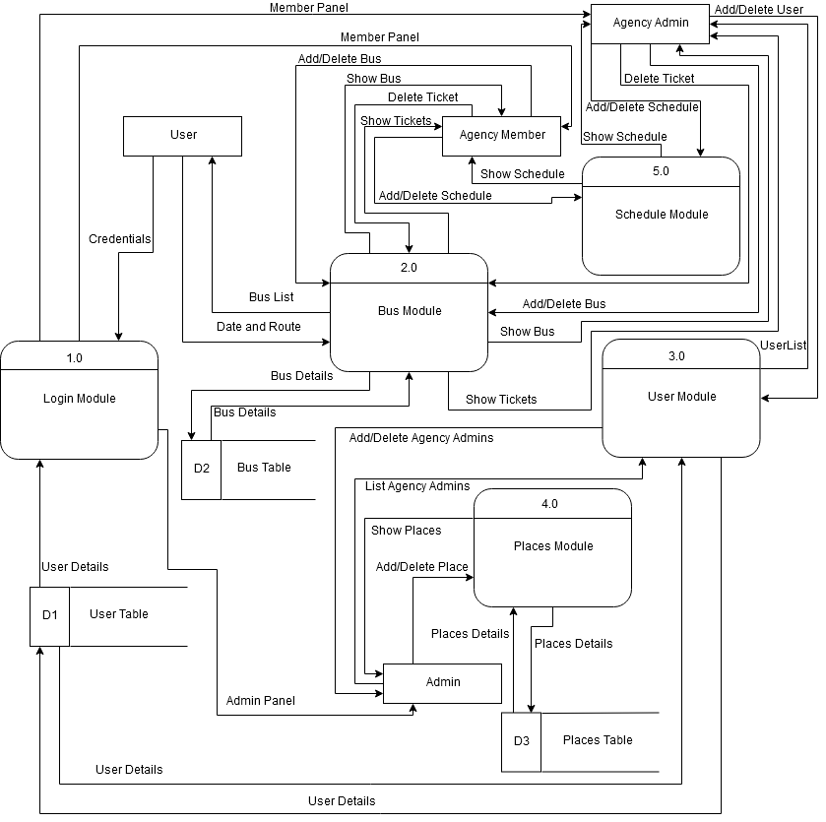
Data Flow Diagram

Slide 12
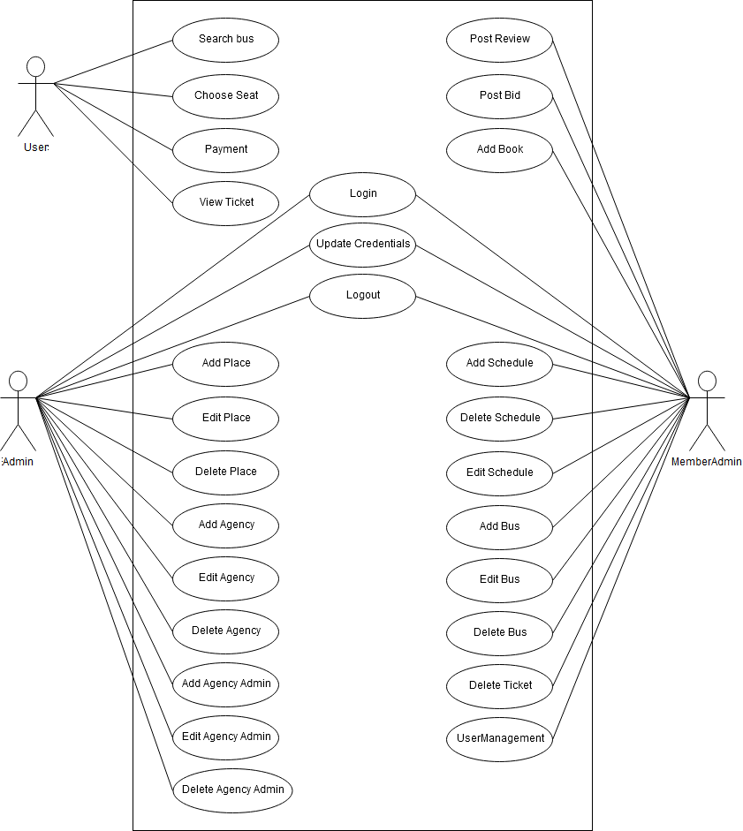
Usecase Diagram

Slide 13
Thank You!

